Slide 1
GEOG0114: Principles of spatial analysis
WEEK 3: spatial autocorrelation & dependence
Dr Anwar Musah (a.musah@ucl.ac.uk)
Lecturer in Social and Geographic Data Science
UCL Geography
1

Slide 2
Contents
To understand the concepts of spatial dependence, and key characteristics of spatial data i.e., spatial heterogeneity and spatial autocorrelation
To understand the concept and importance of a Spatial Weight Matrix (W)
What are spatial weight matrices and how they are created
Contiguity-based weights
Distance-based weights
How do we quantify, measure and interpret the degree spatial dependence “globally” and “locally”?
Global Moran’s I statistic
Local Indicators of Spatial Association (LISA)
Tips on making statistical inference & interpretation of the results churned from methods highlighted in Point 4
Problem
Knowledge
Collect
Model
Wrangle
Explore
2

Slide 3

Quick Recap
We discussed the various types and ways of representing spatial data
In Week 2:
Types of spatial data formats e.g., vector and raster
Spatial operations (aka Geoprocessing)
Clipping
Aggregating
Union
Intersection
Buffering etc.,
Thematic mapping and problems to consider
Choropleths
Proportional mapping
Raster (our main focus for Week 4-6)
But in Week 1:
We spoke of Tobler’s first law of Geography
Spatial dependence, Distance decay, Spatial spillovers
Let’s rewind a bit to last week,
and to the week before last
3
Notes:
Before we start, let’s recap on last week

Slide 4
Formally, what is Spatial Dependance?
4
Notes:
From an analytical context….

Slide 5
Definition [1]
Recall Tobler’s 1st Law of Geography
Spatial dependence is the propensity for how nearby objects in geographic space tend to influence each other. It’s a reflection of how values observed at one location (e.g., city, region, country) is dependent on the values of neighbouring observations from nearby locations.
In this context, there are two overarching characteristics of spatial data:
Spatial autocorrelation
Spatial heterogeneity
5
Notes:
Tobler’s first law which states that…
Now, where in the traditional statistical sense (where geography is basically removed) – the observations regardless of proximity are assumed to be independent. But in spatial statistics; however, it assumes otherwise aka dependence – saying that geographic data tend to be spatially dependent.

Slide 6
Definition [2]
Recall Tobler’s 1st Law of Geography
Spatial dependence is the propensity for how nearby objects in geographic space tend to influence each other. It’s a reflection of how values observed at one location (e.g., city, region, country) is dependent on the values of neighbouring observations from nearby locations.
Spatial autocorrelation
This describes the degree of how spatial locations (i.e., points, areas, or raster cells) close to each other share similar values (i.e., locations that are akin to each other).
6
Notes:
When we are examining spatial autocorrelation – these location-specific

Slide 7
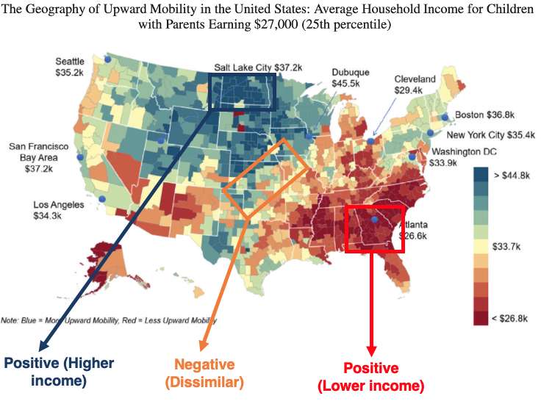
An illustrative example of spatial autocorrelation
Notes: We concern ourselves with areas that are concentrated, or forms clusters of a specific value.
Here, we can see concentrations, or clusters of income in the SE region, high income in the Northern region etc.
7

Slide 8
Definition [3]
Recall Tobler’s 1st Law of Geography
Spatial dependence is the propensity for how nearby objects in geographic space tend to influence each other. It’s a reflection of how values observed at one location (e.g., city, region, country) is dependent on the values of neighbouring observations from nearby locations.
Spatial heterogeneity
This essentially describes the uneven distribution of observed values across the entire geographical space.
8
Notes:
Spatial heterogeneity is the variation of observed values in space, and these variation in can be horizontally, vertically or diagonal-wise

Slide 9
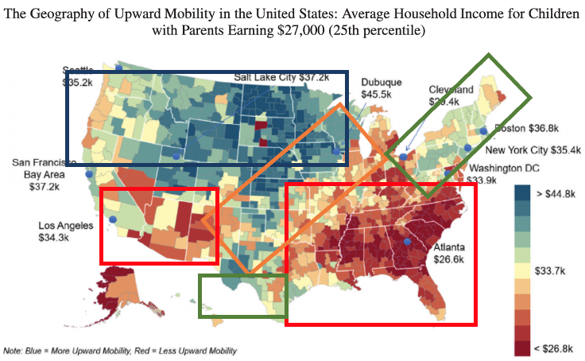
An illustrative example of spatial heterogeneity
Notes: Variation in earnings across the US landscape is spatially heterogeneous – it changes across or “horizontally” US’ landscape.
9

Slide 10
Why is Spatial Dependence important? [1]
Spatial dependence exists for both incident (event) and attribute data that are spatially-referenced (i.e., point, area or raster format)
It is a concept that allows the user to determine if event or attribute spatial data (i.e., some spatial phenomenon) exhibit spatial patterns such as clustering, random distribution or dispersion.
From point 2 concerning patterns of random distribution. Note that in most cases, the distribution of attribute values will seldomly show evidence of Complete Spatial Randomness (CSR)
This concept is a core element incorporated into several spatial analytical techniques
Complete Spatial Randomness (CSR) essentially means that a pattern completely made up by chance. This is an important for understanding spatial dependence and significance in a spatial statistical context, especially when gauging evidence of spatial dependence, as it will always form our “null hypothesis”, while the ”alternative hypothesis” is patterns (i.e., clustering or dispersion) are not by chance.
10

Slide 11
Examples of Spatial Analytical techniques that needs to incorporate this aspect of spatial dependence
For point data (use the spatial configuration of point locations that make-up the study area)
Geostatistical models such as Kriging through usage of semivariogram analysis, and others such as Inverse Distance Weight (IDW). These analyses are a function of distance.
Point process analysis with spatial Bayesian models such as INLA-SPDE through a MESH / projection matrix (which is grid-based and uses distance as a function).
For areal data (use the spatial configuration of areas that make-up the study area)
Spatial autocorrelation, we use Moran’s I Statistics
Spatial clustering
Almost all spatial regression models (i.e., Spatial lags & errors, GWRs, Spatial Bayesian risk models)
What do we mean by spatial configuration of study area?
There has to be some formal mathematical way to explicitly represent or translate geography into some kind of numerical language, or device. We called this device a Spatial Weight Matrix.
11

Slide 12
Spatial Weight Matrices
12

Slide 13

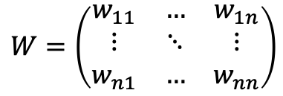
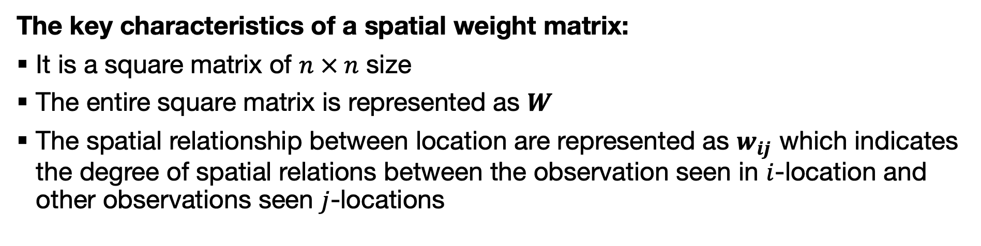
Definition
A Spatial Weight Matrix is a mathematical structure or device used to represent geographical space. It can also be used to indicate the spatial relationship among special features within a defined geographic space.
$W$ looks something like this
The key characteristics of a spatial weight matrix:
It is a square matrix of $n × n$ size
The entire square matrix is represented as $W$
The spatial relationship between location are represented as $w_{ij}$ which indicates the degree of spatial relations between the observation seen in $i$-location and other observations seen $j$-locations
$$W=\left(\begin{matrix}w_{11} & … & w_{1n} \\ ⋮ & ⋱ & ⋮ \\ w_{n1} & … & w_{nn}\end{matrix}\right)$$
Note: The construction and usage of $W$ in a spatial context is quite situational
13
Notes:
The main role for spatial weights is their use as the basis for the construction of various tests for spatial autocorrelation.

Slide 14
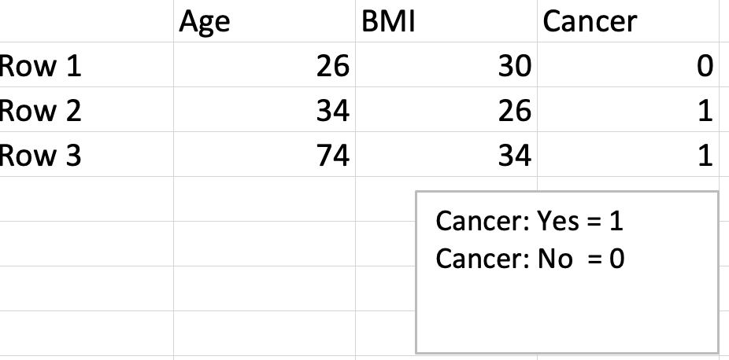
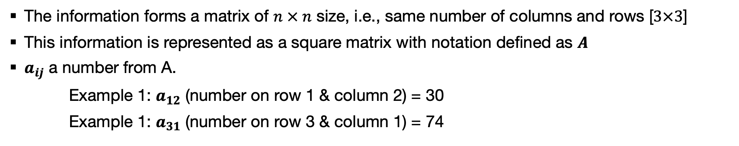
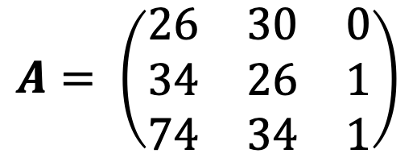
Maths 101: Matrices
A Matrix is a set of number arranged in rows and columns to a rectangular array
Data structure with demographic and health information
$$A= \left(\begin{matrix}26 & 30 & 0 \\ 34 & 26 & 1 \\ 74 & 34 & 1\end{matrix}\right)$$
It contains
3 columns (j)
3 rows (i)
The information forms a matrix of $n × n$ size, i.e., same number of columns and rows [$3×3$]
This information is represented as a square matrix with notation defined as $A$
$a_{ij}$ a number from A.
Example 1: $a_{12}$ (number on row 1 & column 2) = 30
Example 1: $a_{31}$ (number on row 3 & column 1) = 74
14
Notes:
Rectangular with different number of rows and columns
Square matrix with same row and column number.

Slide 15
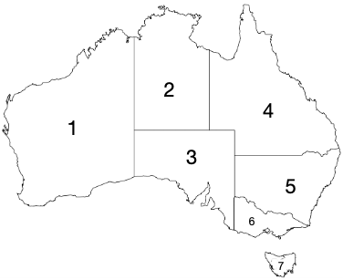
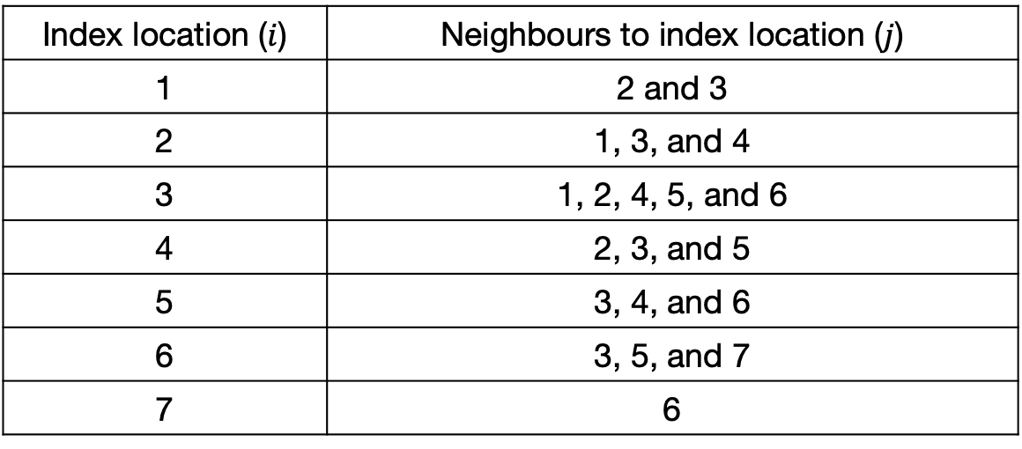
Matrix $W$ and $w_{ij}$ [1]
Remember: The construction and usage of $W$ in a spatial context is quite situational
Situation 1: $W$ represents a neighbouring matrix with binary values (0, 1) only, $w_{ij}$ = 1 if $j$-location is a neighbour of location $i$
Table showing areal adjacency
Index location ($i$) | Neighbours to index location ($j$)
1 | 2 and 3
2 | 1, 3, and 4
3 | 1, 2, 4, 5, and 6
4 | 2, 3, and 5
5 | 3, 4, and 6
6 | 3, 5, and 7
7 | 6
.
1 = Western Australia
2 = Northern territory
3 = South Australia
4 = Queensland
5 = New South Wales & ACT
6 = Victoria
7 = Tasmania
Converting this areal adjacency table to a spatial weight matrix
15
Notes:
Now situation 1

Slide 16
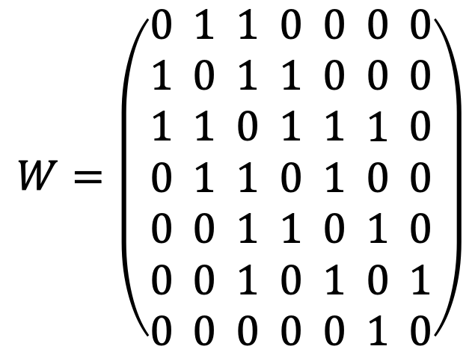
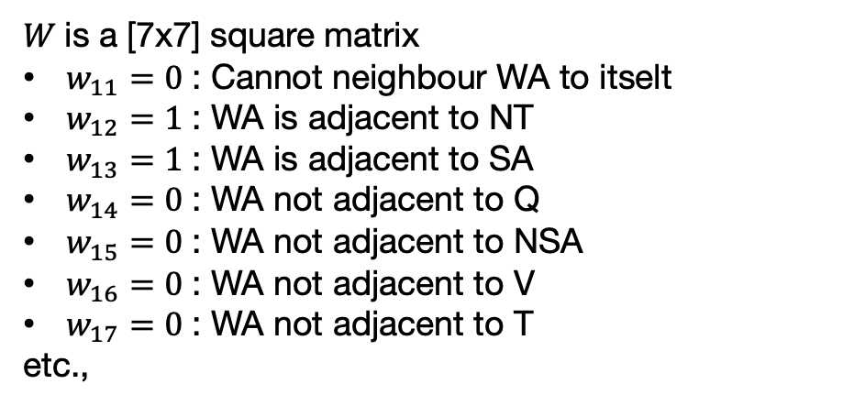
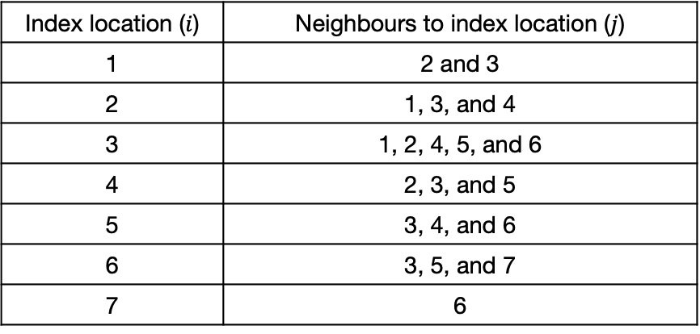
Matrix $W$ and $w_{ij}$ [2]
$W$ is a [7x7] square matrix
$w_{11}=0$ : Cannot neighbour WA to itselt
$w_{12}=1$ : WA is adjacent to NT
$w_{13}=1$ : WA is adjacent to SA
$w_{14}=0$ : WA not adjacent to Q
$w_{15}=0$ : WA not adjacent to NSA
$w_{16}=0$ : WA not adjacent to V
$w_{17}=0$ : WA not adjacent to T
etc.,
Table showing areal adjacency
Index location ($i$) | Neighbours to index location ($j$)
1 | 2 and 3
2 | 1, 3, and 4
3 | 1, 2, 4, 5, and 6
4 | 2, 3, and 5
5 | 3, 4, and 6
6 | 3, 5, and 7
7 | 6
1 2 3 4 5 6 7
$$W=\left(\begin{aligned}0 \\ 1 \\ 1 \\ 0 \\ 0 \\ 0 \\ 0\end{aligned} \begin{aligned}1 \\ 0 \\ 1 \\ 1 \\ 0 \\ 0 \\ 0\end{aligned} \begin{aligned}1 \\ 1 \\ 0 \\ 1 \\ 1 \\ 1 \\ 0\end{aligned} \begin{aligned}0 \\ 1 \\ 1 \\ 0 \\ 1 \\ 0 \\ 0\end{aligned} \begin{aligned}0 \\ 0 \\ 1 \\ 1 \\ 0 \\ 1 \\ 0\end{aligned} \begin{aligned}0 \\ 0 \\ 1 \\ 0 \\ 1 \\ 0 \\ 1\end{aligned} \begin{aligned}0 \\ 0 \\ 0 \\ 0 \\ 0 \\ 1 \\ 0\end{aligned}\right)$$
1
2
3
4
5
6
7
1 = Western Australia (WA)
2 = Northern territory (NT)
3 = South Australia (SA)
4 = Queensland (Q)
5 = New South Wales & ACT (NSA-ACT)
6 = Victoria (V)
7 = Tasmania (T)
16

Slide 17
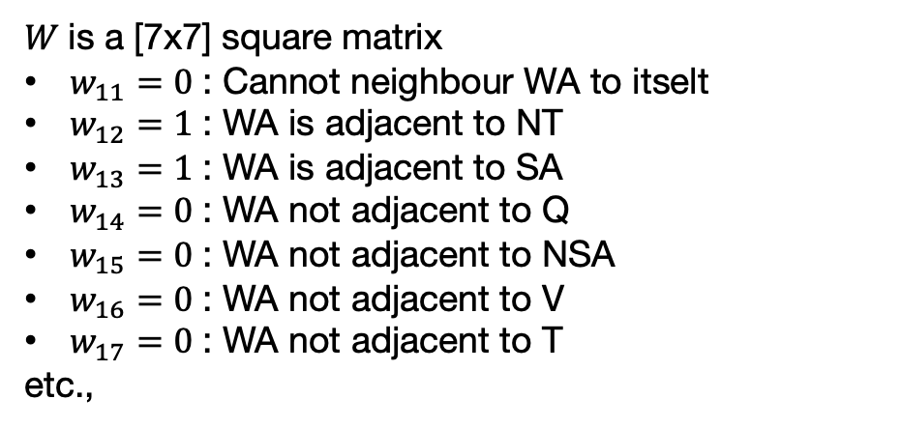
Matrix $W$ and $w_{ij}$ [2]
Situation 1: This type of spatial matrix is Contiguity-Based
Table showing areal adjacency
$W$ is a [7x7] square matrix
$w_{11}=0$ : Cannot neighbour WA to itselt
$w_{12}=1$ : WA is adjacent to NT
$w_{13}=1$ : WA is adjacent to SA
$w_{14}=0$ : WA not adjacent to Q
$w_{15}=0$ : WA not adjacent to NSA
$w_{16}=0$ : WA not adjacent to V
$w_{17}=0$ : WA not adjacent to T
etc.,
Index location ($i$) | Neighbours to index location ($j$)
1 | 2 and 3
2 | 1, 3, and 4
3 | 1, 2, 4, 5, and 6
4 | 2, 3, and 5
5 | 3, 4, and 6
6 | 3, 5, and 7
7 | 6
1 2 3 4 5 6 7
$$W=\left(\begin{aligned}0 \\ 1 \\ 1 \\ 0 \\ 0 \\ 0 \\ 0\end{aligned} \begin{aligned}1 \\ 0 \\ 1 \\ 1 \\ 0 \\ 0 \\ 0\end{aligned} \begin{aligned}1 \\ 1 \\ 0 \\ 1 \\ 1 \\ 1 \\ 0\end{aligned} \begin{aligned}0 \\ 1 \\ 1 \\ 0 \\ 1 \\ 0 \\ 0\end{aligned} \begin{aligned}0 \\ 0 \\ 1 \\ 1 \\ 0 \\ 1 \\ 0\end{aligned} \begin{aligned}0 \\ 0 \\ 1 \\ 0 \\ 1 \\ 0 \\ 1\end{aligned} \begin{aligned}0 \\ 0 \\ 0 \\ 0 \\ 0 \\ 1 \\ 0\end{aligned}\right)$$
1
2
3
4
5
6
7
1 = Western Australia (WA)
2 = Northern territory (NT)
3 = South Australia (SA)
4 = Queensland (Q)
5 = New South Wales & ACT (NSA-ACT)
6 = Victoria (V)
7 = Tasmania (T)
17
Notes:
In its simplest form, the spatial weights matrix expresses the existence of a neighbour relation as a binary relationship, with weights 1 and 0

Slide 18
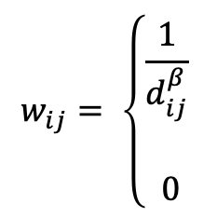
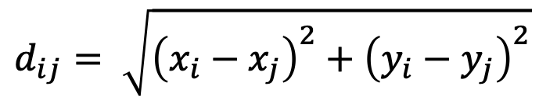
Matrix $W$ and $w_{ij}$ [3]
Remember: The construction and usage of $W$ in a spatial context is quite situational
Situation 2: $W$ represents a matrix with elements $w_{ij}$ when its are based on distance $d_{ij}$ between some location $i$ and $j$. Here, we use point locations, or the centroids of such given area, to compute the distances whereby the coordinates for $i$ is ($x_{i},y_{i}$) and $j$ is ($x_{j},y_{j}$) are used. The goal here is to integrate distance decay.
$$d_{ij}= \sqrt{{\left(x_{i}−x_{j}\right)}^{2}+{\left(y_{i}−y_{j}\right)}^{2}}$$
Euclidean Distance:
[1]
$$w_{ij}= \left\{\begin{aligned}\frac{1}{d_{ij}^{β}} \\ \\ 0\end{aligned}\right.$$
If $i ≠j$ (i.e., dealing with two different locations)
Inverse Distance:
[2]
If $i=j$ (i.e., this basically the same point location)
Note that $β$ = 1 or $β$ = 2 (it’s up to you which ever value you pick!)
18
Notes:
Now situation 2

Slide 19
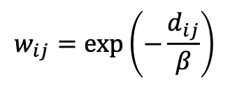
Matrix $W$ and $w_{ij}$ [4]
Remember: The construction and usage of $W$ in a spatial context is quite situational
Situation 2: $W$ represents a matrix with elements $w_{ij}$ when its are based on distance $d_{ij}$ between some location $i$ and $j$. Here, we use point locations, or the centroids of such given area, to compute the distances whereby the coordinates for $i$ is ($x_{i},y_{i}$) and $j$ is ($x_{j},y_{j}$) are used. The goal here is to integrate distance decay.
$$d_{ij}= \sqrt{{\left(x_{i}−x_{j}\right)}^{2}+{\left(y_{i}−y_{j}\right)}^{2}}$$
Euclidean Distance:
[1]
$$w_{ij}=exp\left(−\frac{d_{ij}}{β}\right)$$
[2]
Negative exponential:
Note that $β$ = 1 or $β$ = 2 (it’s up to you which ever value you pick!)
19

Slide 20
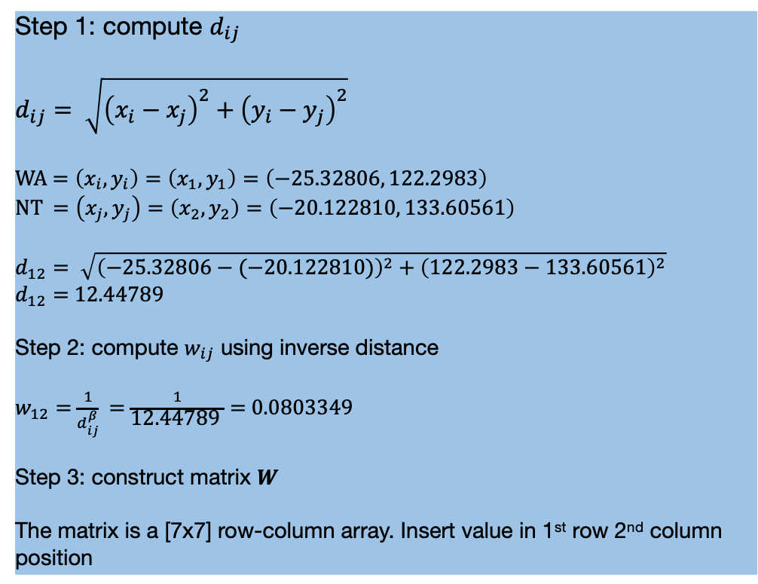
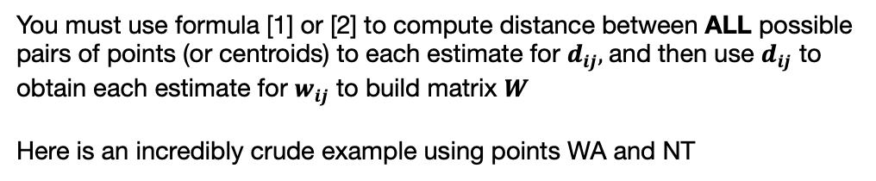
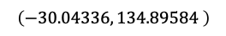
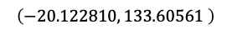
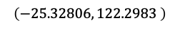
Example: Calculation of Euclidean Distance and $w_{ij}$
You must use formula [1] or [2] to compute distance between ALL possible pairs of points (or centroids) to each estimate for $d_{ij},$and then use $d_{ij}$ to obtain each estimate for $w_{ij}$ to build matrix $W$
Here is an incredibly crude example using points WA and NT
$$\left(−20.122810, 133.60561 \right)$$
Step 1: compute $d_{ij}$
$$d_{ij}= \sqrt{{\left(x_{i}−x_{j}\right)}^{2}+{\left(y_{i}−y_{j}\right)}^{2}}$$
WA $=\left(x_{i},y_{i}\right)=\left(x_{1},y_{1}\right)=\left(−25.32806, 122.2983\right)$
NT $=\left(x_{j},y_{j}\right)=\left(x_{2},y_{2}\right)=\left(−20.122810, 133.60561\right)$
$$d_{12}= \sqrt{{\left(−25.32806−(−20.122810)\right)}^{2}+{\left(122.2983−133.60561\right)}^{2}}$$
$d_{12}=$ 12.44789
Step 2: compute $w_{ij}$ using inverse distance
$w_{12}=$ $\frac{1}{d_{ij}^{β}}$ = $\frac{1}{\text{12.44789 }}$ = 0.0803349
Step 3: construct matrix $W$
The matrix is a [7x7] row-column array. Insert value in 1st row 2nd column position
$$\left(−25.32806, 122.2983 \right)$$
$$\left(−30.04336, 134.89584 \right)$$
1 = Western Australia (WA)
2 = Northern territory (NT)
3 = South Australia (SA)
4 = Queensland (Q)
5 = New South Wales & ACT (NSA-ACT)
6 = Victoria (V)
7 = Tasmania (T)
20

Slide 21
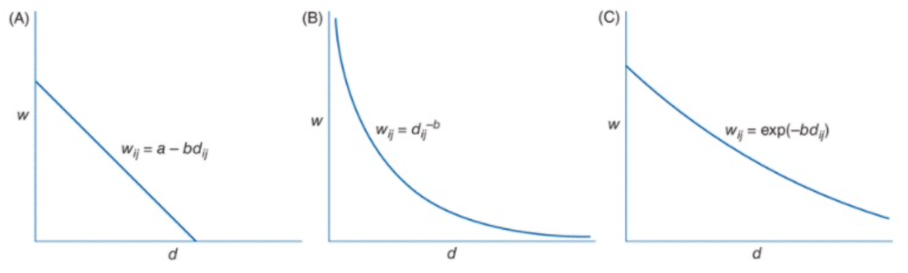
$w_{ij}$ vs $d_{ij}$ is a distance decay function
Linear
Inverse
Negative exponential
21

Slide 22
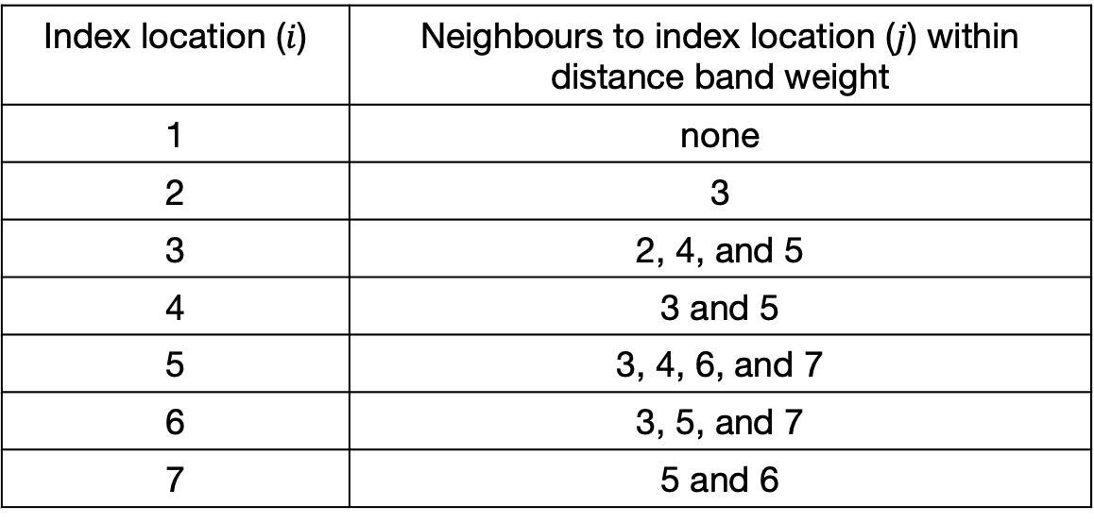
Matrix $W$ and $w_{ij}$ [5]
K-nearest neighbours based on distance: We explicitly limit the number of neighbours by specifying a threshold distance (or distance band weights) to also construct $W$
Index location ($i$) | Neighbours to index location ($j$) within distance band weight
1 | none
2 | 3
3 | 2, 4, and 5
4 | 3 and 5
5 | 3, 4, 6, and 7
6 | 3, 5, and 7
7 | 5 and 6
22

Slide 23
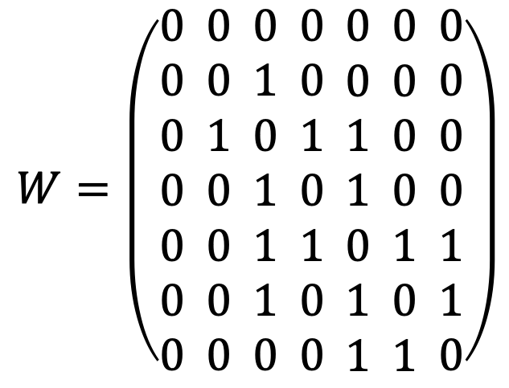
Matrix $W$ and $w_{ij}$ [5]
Situation 2: These types of spatial matrices are Distance-Based
K-nearest neighbours based on distance: We explicitly limit the number of neighbours by specifying a threshold distance (or distance band weights) to also construct $W$
1 2 3 4 5 6 7
$$W=\left(\begin{aligned}0 \\ 0 \\ 0 \\ 0 \\ 0 \\ 0 \\ 0\end{aligned} \begin{aligned}0 \\ 0 \\ 1 \\ 0 \\ 0 \\ 0 \\ 0\end{aligned} \begin{aligned}0 \\ 1 \\ 0 \\ 1 \\ 1 \\ 1 \\ 0\end{aligned} \begin{aligned}0 \\ 0 \\ 1 \\ 0 \\ 1 \\ 0 \\ 0\end{aligned} \begin{aligned}0 \\ 0 \\ 1 \\ 1 \\ 0 \\ 1 \\ 1\end{aligned} \begin{aligned}0 \\ 0 \\ 0 \\ 0 \\ 1 \\ 0 \\ 1\end{aligned} \begin{aligned}0 \\ 0 \\ 0 \\ 0 \\ 1 \\ 1 \\ 0\end{aligned}\right)$$
1
2
3
4
5
6
7
23

Slide 24
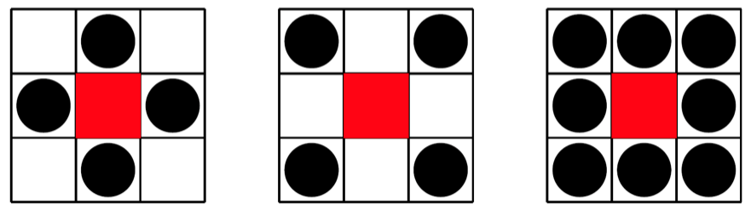
Contiguity-based weights [1]
Note: These are confined to area-based data
Sharing boundaries to any extent
Rook’s Contiguity, these are neighbour locations that share a common border
Bishops’ Contiguity, refers to neighbour locations that ONLY share a single point along its border or boundary.
Queen’s Contiguity is a combination of both the Rook and Bishop, where neighbour locations are allowed to share AT LEAST a single point along its border.
24

Slide 25
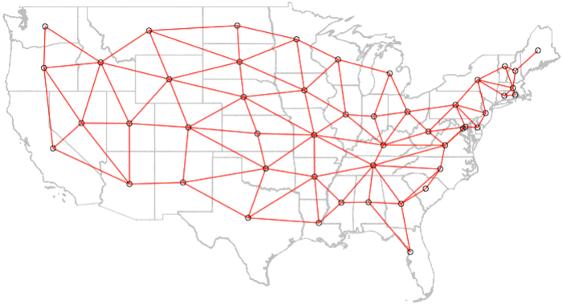
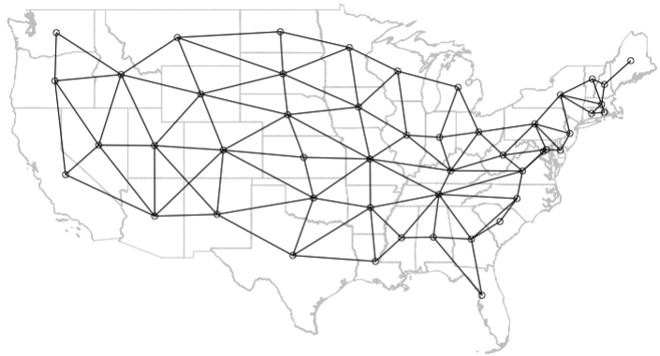
Contiguity-based weights [2]
B
B
A
A
Rook’s contiguity
Queen’s contiguity
25
Notes:
A and B are not neighbours in the Rook’s contiguity matrix but in Queen’s case – they are neighbours.

Slide 26
The Beginning: Introduction to Spatial Analysis and Data Science
Spatial autocorrelation and statistical inference
26

Slide 27
Definition [1]
Spatial autocorrelation: This describes the degree of how spatial locations (i.e., points, areas, or raster cells) close to each other share similar values (i.e., locations that are akin to each other).
We can test our data for spatial autocorrelation, with some form of statistical measure of the similarity of attributes of our data.
We want to distinguish between areas of positively autocorrelated patterns (in which high values are surrounded by high values, and low values by low values, i.e., clusters);
We want to test for random patterns (in which neighbouring values are independent of each other, i.e., CSR); and dispersed patterns (in which high values tend to be surrounded by low values and vice versa).
27

Slide 28
Definition [2]
Spatial autocorrelation: This describes the degree of how spatial locations (i.e., points, areas, or raster cells) close to each other share similar values (i.e., locations that are akin to each other).
The hypothesis statement for testing evidence for spatial autocorrelation
Null hypothesis: The outcome of interest are spatially independent (i.e., patterns are random)
Alternative hypothesis: The outcome of interest are not spatially independent (i.e., hence, there is evidence of clustering or dispersion)
28

Slide 29
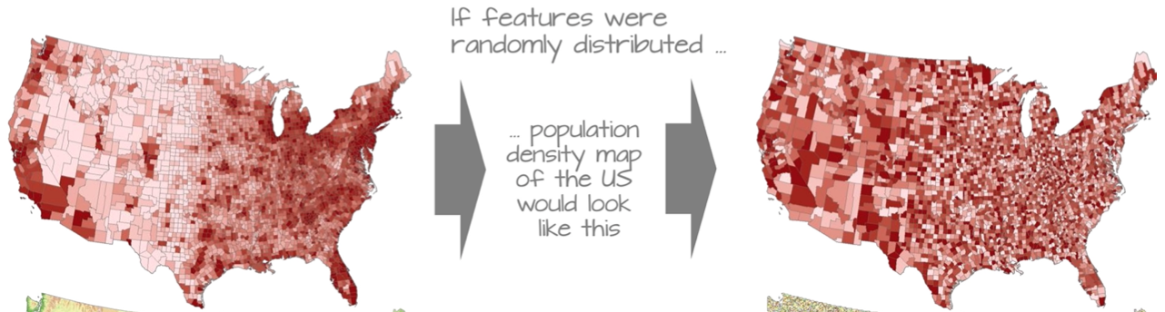




































We can apply these hypotheses tests on these scenarios
Null hypothesis: The spatial patterns for the US Population Density are independent. They are random. [Here, we would reject the null hypothesis]
Alternative hypothesis: The patterns for the US Population Density are not random. They are indeed clustered. [Here, we would accept the alternative hypothesis]
Scenario 1: US Population Density
29
Notes:
Suppose, the image on my right side was true – we would…

Slide 30
































We can apply these hypotheses tests on these scenarios
Null hypothesis: The spatial patterns for the US Population Density are independent. They are random. [Here, we would accept the null hypothesis]
Alternative hypothesis: The patterns for the US Population Density are not random. They are indeed clustered. [Here, we would reject the alternative hypothesis]
Scenario 2: US Population Density
30
Notes:
Suppose, the image here was true – we would…

Slide 31
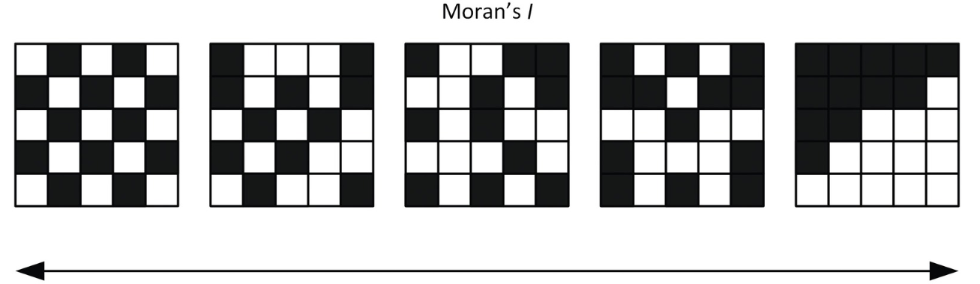
Statistical analysis: Moran’s I statistic [1]
In testing for evidence of spatial autocorrelation, the Moran’s I statistic, which is a weighted correlation coefficient, is the statistical test used to detect departures from spatial randomness. Departures from randomness indicate spatial patterns such as clusters (+) or dispersed (-). This statistic is accompanied with a p-value to determine significance
Dispersed
Random
Clustered
Moran’s I statistic:
-1
0
+1
Positive Moran’s I value is when spatial autocorrelation generally indicates that nearby area have similar values, indicating spatial clustering. This is a spatial pattern!
Negative Moran’s I spatial autocorrelation generally indicates that nearby area have dissimilar values, this is dispersion of values is indeed a spatial pattern!
A Moran’s I value closer to 0 means no evidence of spatial autocorrelation. No discernible spatial pattern!
31

Slide 32
Statistical analysis: Moran’s I statistic [2]
In testing for evidence of spatial autocorrelation, the Moran’s I statistic, which is a weighted correlation coefficient, is the statistical test used to detect departures from spatial randomness. Departures from randomness indicate spatial patterns such as clusters (+) or dispersed (-). This statistic is accompanied with a p-value to determine significance
There are two ways for statistically measuring spatial autocorrelation:
Global Moran’s I statistic: What is the overall spatial dependence across the entire data set area? Studying at a global level will tell you how clustered, dispersed or random the data is distributed over the entire area studied.
LISA (Local Indicators of Spatial Association): What is the difference between each unit of analysis (e.g., areal unit) and its neighbours? We use it for studying at the local level, you can find areas of greater contrast by seeing if places are quantifiably more like or dislike with their neighbours than expected on average.
If the p-value is less than 0.05, we can reject the null hypothesis in favour of the alternative hypothesis and arrive at the conclusion that the patterns are significantly clustered. If the p-value is above 0.05, it means that the clustering/dispersed patterns are not significant, thus we can conclude patterns are random.
32
Notes:
LISA’s are slightly different because these are scores. So, these are not bounded between -1 to +1

Slide 33
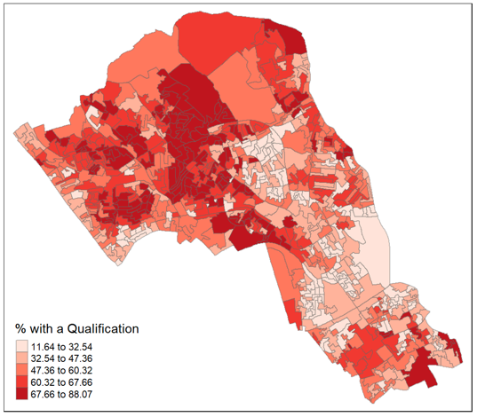
Example:
What is the spatial dependence in qualification in Camden, London?
Step one: Ask, what is the overall spatial dependence in prevalence of qualification across the entire study area i.e., is it clustered, random or dispersed?
Generate the hypothesis
Null hypothesis: The patterns are random
Alternative hypothesis: The patterns are not random (i.e., clustered/dispersed).
Step two: Perform Global Moran’s I test and get a p-value to accept, or reject the null hypothesis
Result (Global Moran’s I = 0.5448 [p=0.0001 < 0.05])
Step three: Interpretation of Global Moran’s I test
We can reject the null hypothesis in favour of the alternative since the Moran’s I statistic’s p-value is less than 0.05. Therefore, The Moran I statistic is 0.54, we can, therefore, determine that there our qualification variable is significantly positively autocorrelated in Camden. In other words, the data does spatially cluster.
Map shows the prevalence (%) of qualification or education attainment levels in postcodes across Camden
33

Slide 34
Example:
What is the spatial dependence in qualification in Camden, London?
Step four: Ask, are there any place-to-place differences in the distribution of qualification holders across the entire study area i.e., hot or cold spots for clusters, and where are they exactly?
Perform the Local Moran’s I test and estimate the following:
Obtain the I values for each get each postcode, and use a divergent colour scheme to categorise them accordingly (negative values are cold spots, positive values are hot spots)
Obtain the I-values’ corresponding p-values for each postcode, and use to determine if the hot/cold spots are significant (i.e., p < 0.05)
P-values are categorised accordingly in this order as ‘Low-low’, ‘Low-high’, ‘Not significant’, ‘High-low’ and ‘High-high’
Plot a map of I-values and p-values.
Map shows the prevalence (%) of qualification or education attainment levels in postcodes across Camden
34

Slide 35
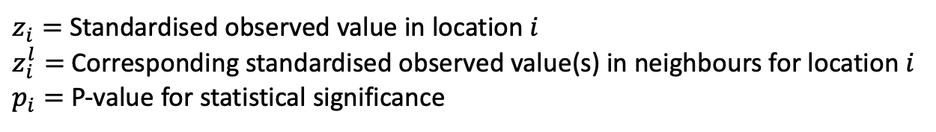
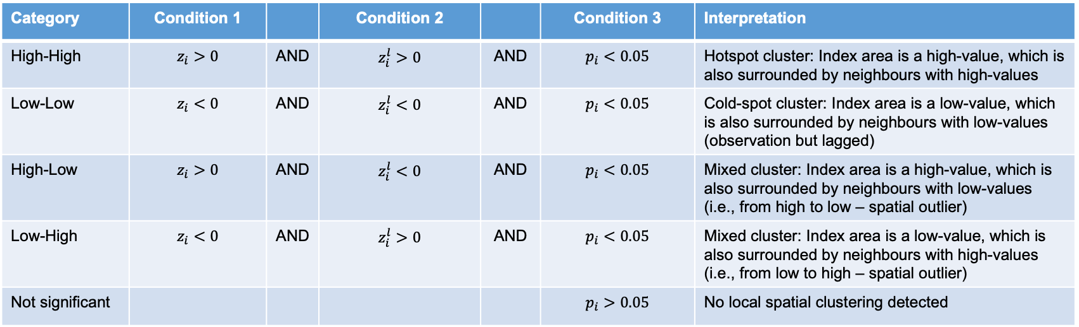
Cluster type and categorisation scheme
Category | Condition 1 |  | Condition 2 |  | Condition 3 | Interpretation
High-High | $$z_{i}>0$$ | AND | $$z_{i}^{l}>0$$ | AND | $$p_{i}<0.05$$ | Hotspot cluster: Index area is a high-value, which is also surrounded by neighbours with high-values
Low-Low | $$z_{i}<0$$ | AND | $$z_{i}^{l}<0$$ | AND | $$p_{i}<0.05$$ | Cold-spot cluster: Index area is a low-value, which is also surrounded by neighbours with low-values (observation but lagged)
High-Low | $$z_{i}>0$$ | AND | $$z_{i}^{l}<0$$ | AND | $$p_{i}<0.05$$ | Mixed cluster: Index area is a high-value, which is also surrounded by neighbours with low-values (i.e., from high to low – spatial outlier)
Low-High | $$z_{i}<0$$ | AND | $$z_{i}^{l}>0$$ | AND | $$p_{i}<0.05$$ | Mixed cluster: Index area is a low-value, which is also surrounded by neighbours with high-values (i.e., from low to high – spatial outlier)
Not significant |  |  |  |  | $$p_{i}>0.05$$ | No local spatial clustering detected
$z_{i}=$Standardised observed value in location$i$
$z_{i}^{l}=$Corresponding standardised observed value(s) in neighbours for location $i$
$p_{i}=$ P-value for statistical significance
35

Slide 36
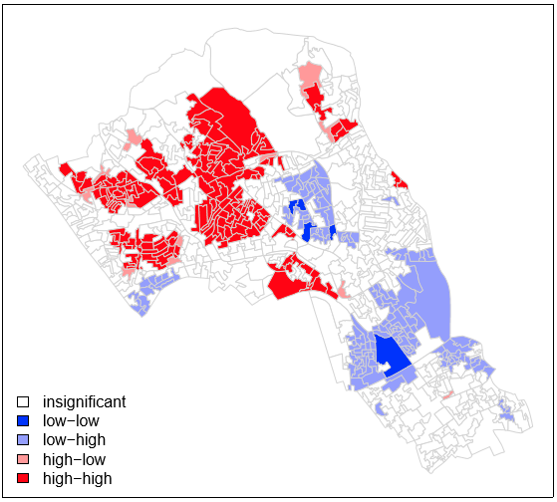
Example:
What is the spatial dependence in qualification in Camden, London?
Map shows the prevalence (%) of qualification or education attainment levels in postcodes across Camden
This is what we want. The p-values helps us to know whether the LISA estimates are statistically significant or not.
36
Notes:
HH: A location with a high value is surrounded by neighbours with high values. This indicates a spatial cluster of high values (positive spatial autocorrelation). Interpretation: It can be seen as a "hot spot.”
LL: A location with a low value is surrounded by neighbours with low values. This indicates a spatial cluster of low values (positive spatial autocorrelation). Interpretation: It can be seen as a "cold spot.”
HL: A location with a high value is surrounded by neighbours with low values. This indicates a spatial outlier (negative spatial autocorrelation). Interpretation: The location deviates from its neighbors, creating a potential anomaly.
LH: A location with a low value is surrounded by neighbours with high values. This also indicates a spatial outlier (negative spatial autocorrelation). Interpretation: Like HL, this suggests the location behaves differently compared to its surroundings.
Overall mean qualification, Spatial-lag mean (direct neighbours)

Slide 37
Summary
The take home message is:
Know the key characteristics of spatial dependence i.e., spatial heterogeneity and spatial autocorrelation
The key for most spatial analysis, especially for spatial autocorrelation, is the derivation of the Spatial Weight Matrix (W)
Know how to quantify, measure and interpret the degree spatial dependence “globally” and “locally” using the Global Moran’s I statistic and Local Indicators of Spatial Association (LISA)
Know how to generate the hypothesis, as well as interpret the results churned by methods highlighted in Point 3
37

Slide 38
Any questions?
38

